Slide 1
Legislative Briefings
Venue | Legislative Offices
State House | Sen. Bruce Tarr, Sen. Walter Timilty, Sen. Jamie Eldridge, Rep. Brad Hill, Rep. James Arciero
Northern Essex Community College | Sen. Diania DiZoglio, Rep. Andy Vargas, Rep. Lenny Mirra, Rep. Christina Minnicucci
UMass Amherst | Sen. Joanne Comerford, Rep. Mindy Domb, Rep. Lindsay Sabadosa
Worcester State University | Sen. Michael Moore
Bridgewater State University | Sen. Marc Pacheco, Sen. Michael Brady, Rep. Kathleen LaNatra
Middlesex Community College | Sen. Edward Kennedy, Rep. Ken Gordon, Rep. Mark Lombardo, Rep. Tom Golden
Massasoit Community College | (scheduled for April 3)

Slide 2
Open Educational Resources Legislative Event
Worcester State University
December 13, 2019

Slide 3
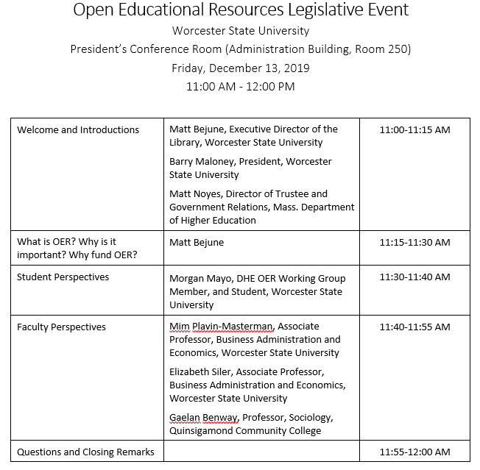

Slide 4
Welcome and Introductions
Matt Bejune, Executive Director of the Library, Worcester State University
Barry Maloney, President, Worcester State University
Matt Noyes, Director of Trustee and Government Relations, MA Department of Higher Education

Slide 5
The Problem
What is OER?
Why is it important?
Why fund OER?
Notes:
We have a problem: textbooks cost so much that students can’t afford to buy them anymore.

Slide 7
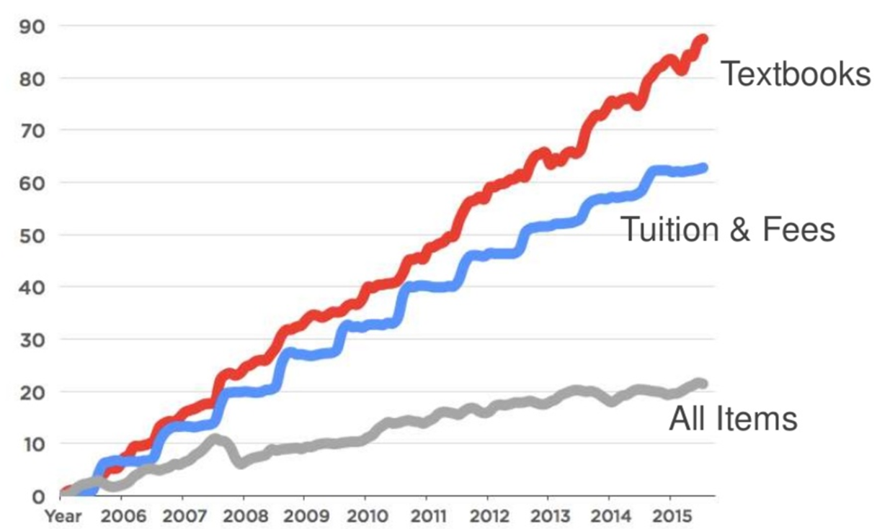
Consumer Prices 2006 - 2016
Notes:
Grey line is the rate of inflation; blue tuition and fees, redline is textbooks, which have increased at four times the rate of inflation. See also: http://www.aei.org/publication/the-new-era-of-the-400-college-textbook-which-is-part-of-the-unsustainable-higher-education-bubble/

Slide 8
http://www.dailytoreador.com/news/library-student-government-hoping-for-solution-to-expensive-book-prices/article_490647b8-36d1-11e8-a857-9325559e8187.html
https://www.nbcnews.com/feature/freshman-year/college-textbook-prices-have-risen-812-percent-1978-n399926
Notes:
Despite growing online markets for discounted books, the average cost of college textbooks has risen 3-4 times faster than the rate of inflation over the past 10 years. It has increased faster than the consumer price index for tuition, healthcare, or housing, rising an astonishing 1045% since 1977.
It has outpaced others – tuition is close.
So, how much are they told to budget yearly?

Slide 9
What are your biggest cost challenges as a student?
Tuition | 61.65%
Course materials | 39.56%
Housing costs | 38.10%
Food expenses | 31.02%
Living expenses | 30.18%
Transportation | 18.49%
Technology | 15.45%
Additional school supplies | 7.66%
Daycare | 3.04%
Other | 2.16%
Student Watch: Attitudes & Behaviors toward Course Materials. 2017-18 Report
Notes:
Here is a list of things that stress students out due to cost, and the cost of course materials is ahead of housing costs and food in terms of causing stress! And speaking of stress, let’s hear from a student directly who is struggling to afford college. Listen to all of the ways in which he copes with the cost challenges and stress.
Cost is an impediment to student success and retention according to the Florida Virtual Campus Survey conducted in 2012 and again in 2016 at every public secondary institution in the state of Florida. Total study population 20K students. Across the four year gap, results are more or less consistent. https://florida.theorangegrove.org/og/items/3a65c507-2510-42d7-814c-ffdefd394b6c/1/
National Org of College Stories –
Getting course materials is their #2 stressor

Slide 10
In your academic career, has the cost of required textbooks caused you to:
64.2% | Not purchase the required textbook
42.8% | Take fewer courses
40.5% | Not register for a specific course
35.6% | Earn a poor grade
22.9% | Drop a course
18.1% | Withdraw from a course
17.2% | Fail a course
https://dlss.flvc.org/documents/210036/1314923/2018+Student+Textbook+and+Course+Materials+Survey+Report+--+FINAL+VERSION+--+20190308.pdf/07478d85-89c2-3742-209a-9cc5df8cd7ea
Notes:
This slide is the key slide in making the point that cost is having an academic impact. We know that not purchasing the required textbook will have an academic impact. The cost of textbooks is impacting students’ choices.
A Florida study of 20,000 students.
Cost is an impediment to student success and retention according to the Florida Virtual Campus Survey conducted in 2012 and again in 2016 at every public secondary institution in the state of Florida. Total study population 20K students. Across the four year gap, results are more or less consistent.
https://florida.theorangegrove.org/og/items/3a65c507-2510-42d7-814c-ffdefd394b6c/1/

Slide 11
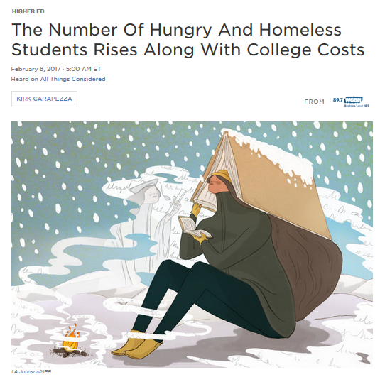
We need to do more …
Sara Goldrick-Rab:
"..they're working, and borrowing, and sometimes still falling so short that they're going without having their basic needs met."
Notes:
We as an institution can do something about this problem. Faculty have agency over which materials they choose for their courses. We have fallen short; evidence: this story from All Things Considered on NPR from February 2017 about a study at University of Wisconsin that looked at food and housing vulnerability among students. 4000 undergrads - 20 percent reported being hungry 13 percent homeless
http://www.npr.org/sections/ed/2017/02/08/513902272/the-number-of-hungry-and-homeless-students-rises-along-with-college-costs Paying the Price

Slide 12
Solutions =
Open Textbooks
& OERs
Notes:
So that’s the problem: public funding is down, tuition and books are up, and students shoulder more work and debt, alongside other strategies that place them at risk, in order to navigate their educational careers and goals. Open textbooks are one solution I’d like to talk to you about today.

Slide 13
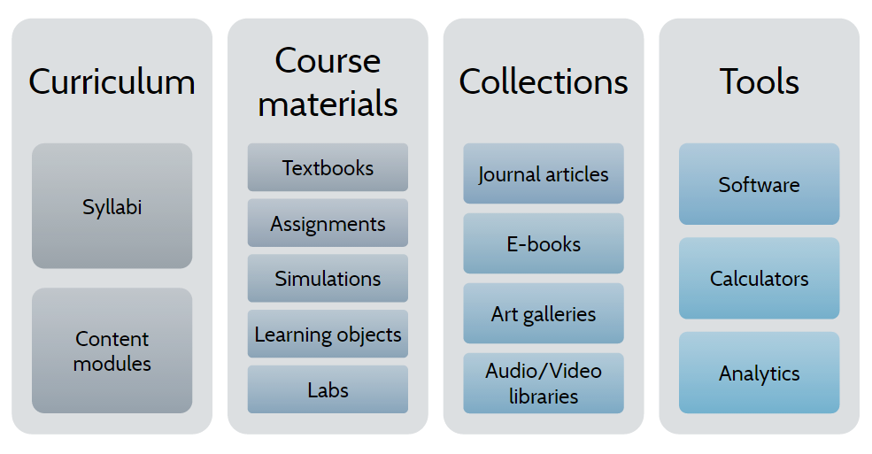
OER: Not just textbooks
Image courtesy of Jeremy Smith and Marilyn Billings, UMass, Amherst.

Slide 14
Common Approaches
Build from scratch
Adapt existing materials
Adopt existing open source text
Develop new materials
Aggregate materials from high-quality OER
Create tools and systems
Create media
Share or publish
Similar in scope to writing a new textbook with lots of collaborators
Identify high-quality OER course or resource
Create significant revision
Share or publish
Similar in scope to moving from traditional to fully online course delivery
Review open course
Refine for teaching approach
Align with syllabus
Assign and reference
Similar in scope to using new text or major new edition

Slide 15
Benefits and Barriers to Students
Benefits
Barriers
Instant unlimited access.
Perpetual access to course materials.
Increased graduation and retention rates.
Learning via multiple formats and genres (podcasts, videos, articles, etc.).
Reduced costs.
Access to electronic materials – parts of Central Massachusetts lack high-speed internet
Printing course materials where possible – school cannot afford to print free copies for every student, and printing is not part of financial aid (as far as we know).
People don’t always have laptops

Slide 16
Benefits to Faculty
Teaching what students need to know in meaningful ways.
Complete control of rich course content.
Resources tailored to fit specific assignments, courses and programs, and learning styles.
Reading genres other than textbooks.
Enable all students to have equal access to course materials on day one.
Open pedagogy improves teaching and learning by engaging students and faculty across the world in the construction of knowledge.

Slide 17
Benefits to Colleges and the State
College affordability is a social justice issue central to the mission of all MPHE institutions as well as the DHE’s Equity Agenda (https://www.mass.edu/strategic/equity.asp).
Addresses the needs of first-generation, and low-SES college students.
The use of OER courses have allowed schools to see:
higher passing rates
higher retention rates / lower withdrawal rates
higher completion and graduation rates
higher student satisfaction
Furthers education is a public good that supports state economic health.
Tremendous cost savings.

Slide 18
WSU Library Open Education Resources Initiative
Launched in Fall 2016 to foster instructional effectiveness and to lower costs for students.
Provided $1,000 mini-grants to faculty to redesign courses using OER.
Funded 34 mini-grants and 37 faculty.
Over 3,100 students and $157,000 in student savings.
And savings continue to grow!
Additional information about OERI: http://libguides.worcester.edu/oeri

Slide 19
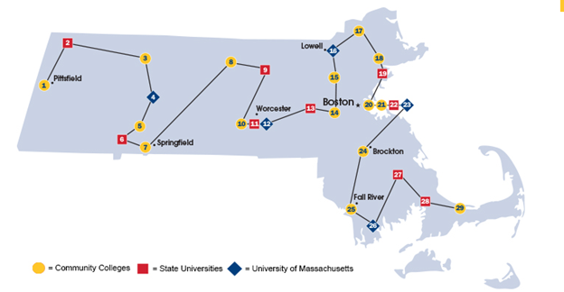
OER Project Funded by MA DHE Higher Education Innovation Fund (HEIF)
Massachusetts Open Education: Achieving Access for All (http://www.mass.edu/strategic/oer.asp)
Collaborative project aimed at building OER capacity across MA
Collaborators included all segments of MA Public Higher Education
UMass Amherst (lead)
Holyoke Community College
Northern Essex Community College
Worcester State University

Slide 20
2011
Open Education Initiative at UMass Amherst established
2016
MA Go Open Project (TAACCCT)
Spring 2018
SAC Resolution in Support of OER
Creation of MA CC OER Hub: https://www.oercommons.org/hubs/masscc
AY 2018-2019
Statewide OER Consortium Project funded by PIF: Baseline Survey and Statewide Faculty Professional Development
Established OER Working Group
Fall 2019
OER Working Group Final Report and Recommendations
approved by the BHE
in October.
Slide courtesy of Patricia A. Marshall, Deputy Commissioner, MA Department of Higher Education

Slide 21
MA DHE OER Project Outcomes
Completed OER Landscape Survey of MA public colleges and universities.
Provided OER training at five regional sites across the Commonwealth.
306 attendees (average of 61 per session).
84 attendees reviewed open textbooks.
Hosted Course Development Day for high enrollment general education classes.
52 attendees developed materials.
Projected year one savings: $631,000!
Acquired statewide membership to the Open Textbook Network.

Slide 22
Student Perspectives
Morgan Mayo, DHE OER Working Group Member, and Worcester State University student

Slide 23
Faculty Perspectives
Mim Plavin-Masterman, Associate Professor, Business Administration and Economics, Worcester State University
Elizabeth Siler, Associate Professor, Business Administration and Economics, Worcester State University
Gaelan Benway, Professor, Sociology, Quinsigamond Community College

Slide 24
Faculty Perspective: Mim and Elizabeth
Business Administration and Economics is largest major at WSU – 900 students
Used OER for at least 3 years and have affected hundreds of students
Elizabeth – Strategy, Principles of Management, Organizational Behavior, and Negotiations
Mim – Strategy, Small Business Management, Organizational Behavior, Administrative Practices and Management, Management and Organizations I, and Organizational Theory

Slide 25
OER Examples
Create a digital reading packet combining scholarly articles, mainstream articles, podcasts, and videos (OB) -- BUILD
Use materials from existing open source repositories (Negotiations) -- ADAPT
Use an open source textbook and supplement with articles and videos (Strategy) --ADOPT

Slide 26
What We Did: Organizational Behavior A required 300-level course for Business majors
We got here over time -- for me, it came about because of my interdisciplinary background (Sociology PhD and MBA).
I think social networks are important and missing from textbooks
I also think organizational culture is more important than just one chapter in a book
Compiled resources for each module: blog posts, podcasts, newspaper and magazine articles, summaries of articles, copies of out-of-copyright works, videos, worksheets, our own PPT presentations...
Wrote our own quizzes and/or questions about the readings
Posted resources on our school’s Google drive, with a link on each course’s Blackboard site.

Slide 27
We teach Organizational Behavior in a way that is fully consistent with our goals for the course and our understanding of the topic.
In OB -- we’re using basically the same assignment over and over in varying degrees of complexity,
In some cases, going back to original sources of ideas and combining that with new applications or empirical examples
Including sociological and structural aspects of organizational problems
Easier to integrate concepts across courses--like power + diversity, power + conflict, money + motivation
Teaching that there is no single correct answer to most OB problems--the best solution will depend on the

Slide 28
What We Did: Negotiation A 300-level elective course for Business majors
This course was not taught using OER exclusively. Elizabeth used a textbook that students could purchase or read on reserve. Then, for experiential activities, she used resources from this MIT OpenCourseWare class on Negotiation: https://ocw.mit.edu/courses/sloan-school-of-management/15-667-negotiation-and-conflict-management-spring-2001/
What was especially useful was being able to use and adapt Mary Rowe’s role plays and simulations to her own students, and to legally use them for free.

Slide 29
What We Did: Strategy The capstone course for Business majors
Worked with students to map an open-source textbook to the existing textbook
Students “cross-walked” the old textbook to the new by matching chapters in each, summarizing the chapters, and identifying things in the old text that were not in the new text.
Students wrote quiz questions about the readings
We compiled resources for each topic that students identified as lacking – could be copies of out-of-copyright works, videos, or podcasts.
Posted resources on our school’s Google drive, with a link on each course’s Blackboard site.

Slide 30
Resources
Institutional repositories (http://www.opendoar.org, https://oasis.geneseo.edu/index.php, https://oerworkshop.commons.gc.cuny.edu/)
Figshare (https://figshare.com)
OER Commons (https://www.oercommons.org/oer)
Socarxiv (https://osf.io/preprints/socarxiv)
Open Science Repository (http://www.open-science-repository.com)
arXiv (https://arxiv.org) (and other pre-print servers)
MIT Open Course Ware (https://ocw.mit.edu/index.htm)
AVOID -- Academia.edu, SciHub, and Researchgate

Slide 31
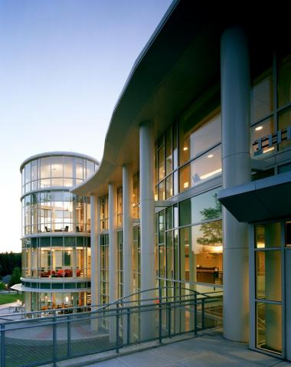
Faculty Perspective: Gaelan Benway
Commonwealth
Discipline-specific collaborations via Go Open grants
4
Campus
Equity and Excellence Experience
Assignment Design and Assessment Toolkits
3
Departments
Digital Course Templates (not all OER)
Highest-enrolled gateway courses
OER LibGuide
2
Classrooms
Faculty adopting or adapting OER
Faculty developing own OER
Faculty collaborating with students
1

Slide 32
Questions and Discussion

